Slide 1
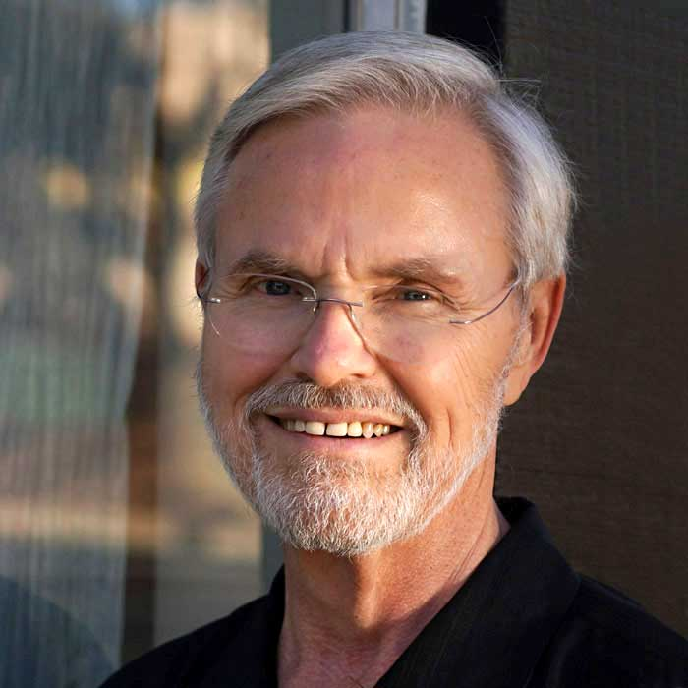
Part 1: An Explanation of Consciousness
Frank Heile, Ph.D.
January 9th, 2021
Presented at “The Stoa”

Slide 2
This Explanation is Based on Three Ideas:
The “Good Regulator Theorem”
Which proves that a good agent needs to have a model of the world where the agent operates
A Proposed Two-Agent model of the Human Brain
Attention Schema Theory of Consciousness
Proposed by Princeton Prof. Michael Graziano ^{[1]}
^{[1]} (Graziano & Webb, 2015)

Slide 3
Outline
Agents and World Models
The Two Agent Model
Attention Mechanisms
Applying Attention Schema Theory
Possible Human Self-Models

Slide 4
Agents and World Models

Slide 5
Agents
An Agent is an entity, that
Has goals,
A way of sensing the world, and
A way to make changes to the world
to achieve those goals

Slide 6
The Good Regulator Theorem:
A theorem from control theory says: “Every Good Regulator of a System Must Be a Model of That System” ^{[1]}
Therefore, a good agent needs:
A Model of the World (WM)
A good agent is optimally simple and optimally effective
If an agent is part of the world then that agent needs a Self-Model (SM)
^{[1]} (Conant & Ashby, 1970)

Slide 7
The Good Regulator Theorem:
Each Human contains:
A Model of the World (WM)
A Sensory World Model,
An Abstract Conceptual World Model,
Memories of sensory and language inputs,
Many models of other humans they know and interact with, and
A Self-model of the human themselves

Slide 8
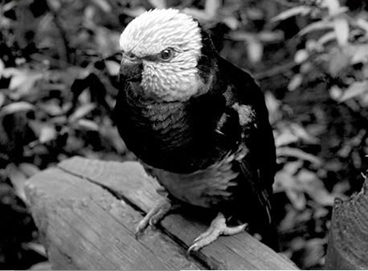
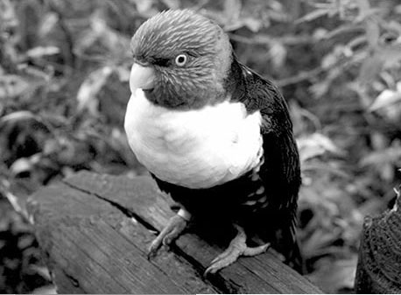
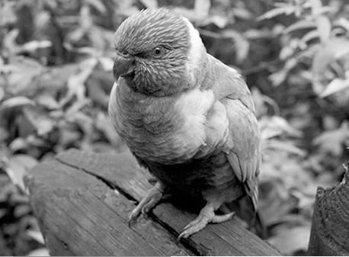
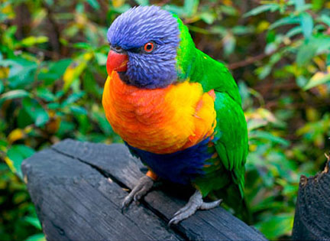
Do We Experience the World OR Our Model of the World?
Short Wavelength Blue Light
Long Wavelength Red Light
Colors
Colors
Exist Only in
Our Model of
the World
Medium Wavelength Green Light

Slide 9
Color Illusion
Left Rectangle Right Rectangle

Slide 10
Color Illusion
1
2
3
3
Left Rectangle Right Rectangle

Slide 11
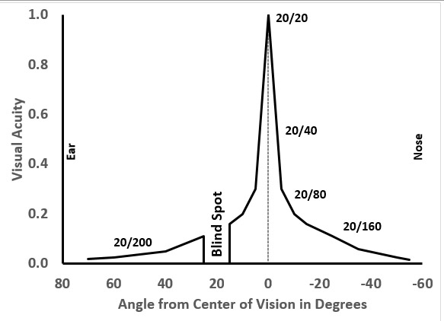
What We Experience is NOT What the Eyes Send to the Brain
Peripheral Visual Acuity vs Angle

Slide 12
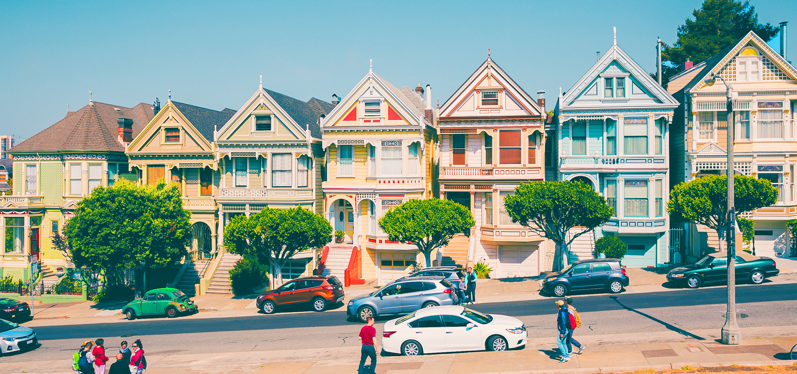
What We Experience is NOT What the Eyes Send to the Brain
Crisp and in Focus

Slide 13
What We Experience is NOT What the Eyes Send to the Brain
Blind
Spot

Slide 14
What We Experience is the World Model, NOT What the Eyes Send to the Brain

Slide 15
What We Experience is the World Model, NOT What the Eyes Send to the Brain
Another Example:
Rapid Eye Saccades…

Slide 16
Every Sensory Experience is Arbitrary
In vision, the experience of color is arbitrary :
Photo-receptors in the Retina
Axons in the Optic Nerve
Neurons in the Brain that Process…
Now (Was)
Experience
Red
Experience
(Blue)
Red Photo-receptors
“Red” signals
Green
Experience
(Red)
Green Photo-receptors
“Green” signals
Blue
Experience
Blue Photo-receptors
“Blue” signals
(Green)

Slide 17
Every Agent Maintains a Model of the World
Each sensory experience is, effectively, the “label” for a particular aspect of the model:
“Red,” “Green,” & “Blue” visual experiences are approximate “labels” for “wavelengths of light”
“Warm,” & “Cool” touch experiences are “labels” for “temperatures of surfaces”
The experience of our body is the experience of our own self-model in the model of the world

Slide 18
Therefore
We are human self-models living in and experiencing our model of the world
Perception is the Experience of our World Model

Slide 19
Two Agent Model

Slide 20
The Two Agent Model:
Controller:
Controls the Body
Modeler:
Creates the World Model

Slide 21
The Two Agent Model:
Controller: Controls the Body
Produces all behaviors and speech
Produces the inner voice or inner visualizations that we experience
Produces the feelings and emotions that we experience

Slide 22
The Two Agent Model:
The Modeler is required by the Good Regulator Theorem
The Modeler includes:
Sensory model of the world
Abstract Conceptual World
Directs attention appropriately
A continuum from low-level Sensory concepts to the Conceptual World

Slide 23
The Two Agent Model of the Human Brain
Modern Human Brain
Modeler
Thoughts
Produces inner voice & visualization
Sensory World Model, Conceptual World,
and Directs Attention,
includes
Intuition, plus
Goals and Self-Models for all three Agents
Spoken & Written Language Input
Spoken & Written Language Output
Controller
Controls
the Body
Vision, Hearing, & All Body Senses
Control all Muscles and Glands
Produces feelings and emotions

Slide 24
Attention Mechanisms

Slide 25
Directing Attention and Awareness
Directing Attention to an Object results in an Experience of Awareness of that Object
This is the Focal Attention Mechanism that gives the Focal Awareness Experience

Slide 26
Focal Attention and Focal Awareness

Slide 27
2 Models of the Focal Attention Mechanism
The Focal Attention Schema is a simplified model of the Focal Attention Mechanism
This model is required by the Good Regulator Theorem
This Focal Attention Schema includes:
The modality
The locations of the attention targets
Any specific features attended
The Focal Model is the contents of awareness
The Focal Attention Mechanism…
Arrow
Location

Slide 28
Focal Attention and Focal Awareness
World Model (WM):
Focal Attention Schema (FAS):

Slide 29
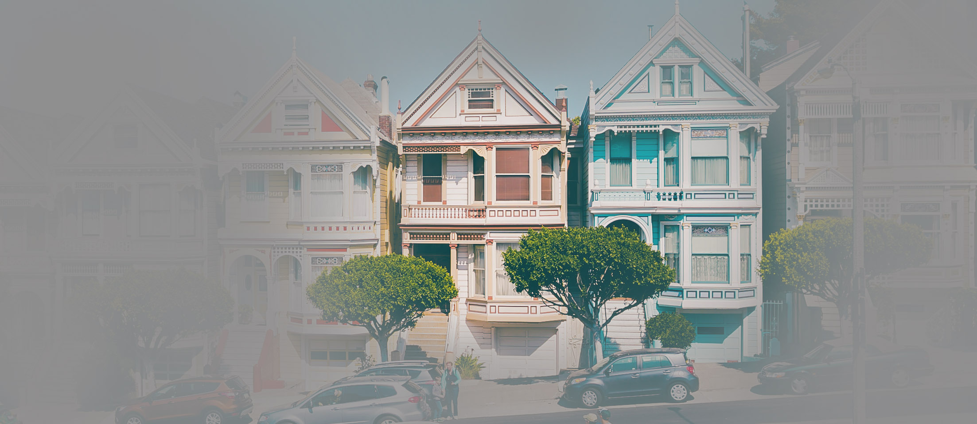
Focal Attention and Focal Awareness
Focal Model
(FM):
Focal Attention Schema (FAS):

Slide 30
Focal Attention and Focal Awareness
The Focal Attention Schema is a simplified model of the Focal Attention Mechanism
The Focal Attention Mechanism gives us the Focal Awareness Experience
Attention Schema Theory says that:
The Focal Attention Schema is a simplified model of the Focal Awareness Experience

Slide 31
Attention Schema Theory
The Focal Attention Schema is a simplified model of the Focal Awareness Experience

Slide 32
Attention Schema Theory
The Focal Attention Schema is a simplified model of the Focal Awareness Experience
AST Model of Focal Awareness:
Claims Focal Awareness
In Words:
An Agent
Of an Object
Focal Awareness Experience
Focal Attention Schema
Self- Model
₊
₊
Focal Model
In Models:

Slide 33
Focal Awareness vs Diffuse Awareness

Slide 34
Focal Attention Mechanism Models
Directing Focal Attention to Objects gives Focal Awareness which involves:
The Focal Attention Schemas and
Awareness of the Focal Models

Slide 35
Propose Diffuse Attention Mechanism Models
Directing Diffuse Attention to the World gives Diffuse Awareness which involves:
The Diffuse Attention Schema and
Awareness of the World Model
Hypothesis

Slide 36
The Modeler’s “Complete World” Model
Diffuse Attention Mechanism
Focal Attention Mechanism
Diffuse Attention Schema
World
Model
Focal Attention
Schema
Focal
Model
DAS
WM FAS FM
The “Complete World”

Slide 37
Diffuse Attention and Diffuse Awareness
The Diffuse Attention Schema is a simplified model of the Diffuse Attention Mechanism
The Diffuse Attention Mechanism gives us the Diffuse Awareness Experience
Extend Attention Schema Theory to say:
The Diffuse Attention Schema is a simplified model of the Diffuse Awareness Experience

Slide 38
Extended Attention Schema Theory
The Diffuse Attention Schema is a simplified model of the Diffuse Awareness Experience

Slide 39
Extended Attention Schema Theory
The Diffuse Attention Schema is a simplified model of the Diffuse Awareness Experience
AST Model of Diffuse Awareness:
Claims Diffuse Awareness
In Words:
An Agent
Of the World
Diffuse Awareness Experience
Diffuse Attention Schema
Self- Model
₊
₊
World Model
In Models:

Slide 40
Types of Attention:
Top-Down Focal Attention Mechanism
Attention Target chosen by the Controller
Bottom-Up Focal Attention Mechanism
Attention Target chosen by the Modeler
The Modeler uses the Diffuse Attention Mechanism to find BU attention targets
Hypothesis

Slide 41
The Diffuse Attention Mechanism
Produces the Diffuse Awareness Experience
Finds Bottom-Up Focal Attention Targets
Updates the World Model based on the current sensory inputs
All three “actions” require that attention is paid to the entire World Model!
Hypothesis

Slide 42
The Modeler’s “Complete World”
Diffuse Attention Mechanism
Focal Attention Mechanism
Updates the World Model Finds BU Focal Attention Targets Produces the Diffuse Awareness Experience
Implements TD and BU Focal Attention Produces the Focal Awareness Experience
Diffuse Attention Schema
World
Model
Focal Attention
Schema
Focal
Model
DAS
WM FAS FM
The “Complete World”

Slide 43
The Attention Mechanisms
Modern Human Brain
Modeler
Produces inner voice & visualization
Sensory World Model, Conceptual World,
and Directs Attention,
includes
Intuition, plus
Goals and Self-Models for all three Agents
Spoken & Written Language Input
Spoken & Written Language Output
Controller
Focal Attention Mechanism
Focal Models and Focal Attention Schemas
Controls
the Body
Part of the
Focal Attention Mechanism
Diffuse Attention Mechanism
The World Model and the Diffuse Attention Schema
Vision, Hearing, & All Body Senses
Control all Muscles and Glands
Produces feelings and emotions

Slide 44
The Modeler’s “Complete World”
Diffuse Attention Mechanism Updates the World & finds BU Focal Targets
Focal Attention Mechanism
is used for both TD & BU Focal Attention
Only the Modeler has Diffuse Awareness
Controller & Modeler can
have Focal Awareness
Diffuse Attention Schema
World
Model
Focal Attention
Schema
Focal
Model
DAS
WM FAS FM
The “Complete World”

Slide 45
Focal & Diffuse Mechanism are Connected
Modern Human Brain
Modeler
Produces inner voice & visualization
Sensory World Model, Conceptual World,
and Directs Attention,
includes
Intuition, plus
Goals and Self-Models for all three Agents
Spoken & Written Language Input
Spoken & Written Language Output
Controller
Focal Attention Mechanism
Focal Models and Focal Attention Schemas
Controls
the Body
- - - - - - - - - - - - - - - - - - - - - - - - - - - - - - - - - - - - - - - - - - - - -
Diffuse Attention Mechanism
The World Model and the Diffuse Attention Schema
Vision, Hearing, & All Body Senses
Control all Muscles and Glands
Produces feelings and emotions

Slide 46
Awareness
All these Diffuse Attention Schema arrow locations determine all possible attention targets
Each of these possible attention target locations can directly affect the World Model!
The World Model never changes without the possibility of the Controller having awareness of WHY the World Model has changed

Slide 47
Awareness of Brain Processes?
Only the brain processes that can directly affect the World Model are candidates for awareness!
That’s why all of the Modeler is unconscious except for the actual World Model itself
We are aware of the sensory and language inputs, only when they directly change the World Model. Hence, all the internal Modeler processing is unconscious.

Slide 48
Awareness of Brain Processes?
Only the brain processes that can directly affect the World Model are candidates for awareness!
All of the Controller is unconscious except for Thoughts, Feelings and Emotions
This is because Thoughts, Feelings and Emotions are inputs to the Modeler that can change the World Model

Slide 49
Focal Attention Mechanism Summary:
Implements both Top-Down and Bottom-Up Focal Attention
Produces Focal Awareness Experiences
Per Attention Schema Theory
The Focal Attention Schema is a model of the Focal Awareness Experience

Slide 50
Diffuse Attention Mechanism Summary:
Updates the World Model
Finds Bottom-Up Focal Attention Targets
Produces Diffuse Awareness Experience
Per Extended Attention Schema Theory
The Diffuse Attention Schema is a model of the Diffuse Awareness Experience

Slide 51
Applying Attention Schema Theory

Slide 52
Controller’s Self-Model has two parts:
In the Abstract Conceptual World Model:
I/Me/My
In the Sensory World Model:
Body Schema
= The conceptual autobiographical narrative self model
= The sensory model of the physical body

Slide 53
Self-Models
Controller’s Self-Model:
I/Me/My
Modeler’s Self-Model:
?
+ Body Schema

Slide 54
Modeler’s Self-Model in the Complete World
In the Diffuse Attention World
In the Focal Awareness World
Diffuse Attention Mechanism Updates the World & finds BU Focal Targets
Focal Attention Mechanism
…directs both TD & BU Focal Attention
Only the Modeler has Diffuse Awareness
Controller & Modeler can
have Focal Awareness
Diffuse Attention Schema
World
Model
Focal Attention
Schema
Focal
Model
Modeler’s Focal Self-Model
Modeler’s Diffuse Self-Model
DAS
WM FAS FM
The “Complete World”

Slide 55
Self-Models
Controller’s Self-Model:
I/Me/My
Modeler’s Self-Model:
Focal Attention Schema (for Focal Awareness) +
Diffuse Attention Schema (for Diffuse Awareness)
+ Body Schema

Slide 56
Self-Models for the Three Agents:
“Focal Awareness” Self-Models
Controller | I/Me/My + Body Schema
Modeler
Human
Awareness
Focal+Diffuse Attention Schemas
(AKA )
(AKA Focal+Diffuse Attention Schemas)
Some combination of the Controller
And Modeler self-models shown above

Slide 57
Attention Schema Theory (AST)
AST says an agent is “aware” only if it has a Focal or Diffuse Attention Schema ^{[1]}
Only the Modeler has a Focal Attention Schema or a Diffuse Attention Schema.
Only the Modeler has conscious awareness all by itself!
^{[1]} (Graziano, 2016)

Slide 58
To get 3 Conscious “Agents” we need to add the Modeler to the other Agents
Modeler Consciousness = Modeler Only
Using the Modeler Self-model = Awareness
Controller Consciousness = Controller + Modeler
Using the Controller’s Self-model = I/Me/My + Body Schema
Human Consciousness = Controller Consciousness + Modeler Consciousness
Using a Human Self-model that is a combination of the Controller and Modeler Self-models in various proportions

Slide 59
Define Fundamental Consciousness
Diffuse Attention Mechanism Updates the World & finds BU Focal Targets
Focal Attention Mechanism
is used for both TD & BU Focal Attention
Modeler’s Diffuse Awareness
Modeler’s
Focal Awareness
Diffuse Attention Schema
World
Model
Focal Attention
Schema
Focal
Model
DAS
WM FAS FM
The “Complete World”

Slide 60
Ned Block’s Phenomenal Consciousness vs Access-Consciousness
Phenomenal Consciousness is experience;
The phenomenally conscious aspect of a state is what it is like to be in that state—i.e. the qualia
Access-Consciousness is availability for use in reasoning and guiding speech and action
Only the Controller reasons, speaks, & acts
Phenomenal Awareness is experience;
Access-Awareness is availability for use
Hard Problem: Explaining why there is “something it is like” for a subject in a conscious experience.

Slide 61
Ned Block’s Phenomenal Consciousness vs Access-Consciousness
Modern Human Brain
Modeler
Produces inner voice & visualization
Sensory World Model, Conceptual World,
and Directs Attention,
includes
Intuition, plus
Goals and Self-Models for all three Agents
Spoken & Written Language Input
Spoken & Written Language Output
Controller
Focal Attention Mechanism
Focal Models and Focal Attention Schemas
Controls
the Body
Diffuse Attention Mechanism
The World Model and the Diffuse Attention Schema
Vision, Hearing, & All Body Senses
Control all Muscles and Glands
Produces feelings and emotions

Slide 62
Ned Block’s Phenomenal Consciousness vs Access-Consciousness
Modern Human Brain
Modeler
Phenomenal Consciousness of Focal Awareness
Produces inner voice & visualization
Sensory World Model, Conceptual World,
and Directs Attention,
includes
Intuition, plus
Goals and Self-Models for all three Agents
Spoken & Written Language Input
Phenomenal Consciousness of Focal Awareness
Spoken & Written Language Output
Controller
Focal Awareness . Focal Models and Focal Attention Schemas
Phenomenal Consciousness of Focal Awareness and Diffuse Awareness
Controls
the Body
Phenomenal Consciousness of Focal Awareness
…of the Focal Model
Access Consciousness of Focal Awareness
Diffuse Awareness
The World Model and the Diffuse Attention Schema
Phenomenal Consciousness of Diffuse Awareness
Vision, Hearing, & All Body Senses
…of the World Model
Control all Muscles and Glands
Produces feelings and emotions

Slide 63
Ned Block’s Phenomenal Consciousness vs Access-Consciousness
Modern Human Brain
Modeler
Produces inner voice & visualization
Sensory World Model, Conceptual World,
and Directs Attention,
includes
Intuition, plus
Goals and Self-Models for all three Agents
Spoken & Written Language Input
Spoken & Written Language Output
Controller
Focal Awareness . Focal Models and Focal Attention Schemas
Controls
the Body
Phenomenal Consciousness
Access Consciousness
Diffuse Awareness
The World Model and the Diffuse Attention Schema
Vision, Hearing, & All Body Senses
Control all Muscles and Glands
Produces feelings and emotions

Slide 64
How Does the Controller Report “Colors”?
Controller has this :word: label
Focal Model
Modeler has this :experience: label
?
Type=Pixel Color=Lime Green
Property
Label
Type=Concept
Sub-Type=Object Category=Apple
Color=Green
Type=Concept Sub-Type=Object Category=Stem
Color=Brown

Slide 65
Hard Problem: Explaining why there is “something it is like” for a subject in a conscious experience.
From the Controller’s Point of View:
The Green Color Experience seems like it is Out Here
The Body
I/Me/My
Sense
Organs
Sees
Looking Out
This is HARD to explain: How can an “experience” exist out in the world?

Slide 66
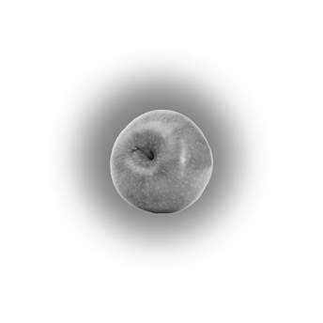
Hard Problem: Explaining why there is “something it is like” for a subject in a conscious experience.
The Truth:
However, the Green Color Experience is actually in the Focal Attention Schema
The Controller / Body
It seems like the Green Color Experience is on the apple
The Modeller / World Model
Sense
Organs
Controller’s Self-model:
Body Schema
+ I/Me/My
Information
Information
Awareness
Attention
This is EASIER to explain: “green” is the label for the color property of the object, but the “experience” is in the FAS in the Complete World—it is not even in the actual World Model at all!

Slide 67
The Modeler’s “Complete World”
Diffuse Attention Mechanism
Focal Attention Mechanism
The Apple Object
Green Color Experience
Diffuse Attention Schema
World
Model
Focal Attention
Schema
Focal
Model
DAS
WM FAS FM
The “Complete World”

Slide 68
Attention Schema Theory (AST) ^{[1]}
Attention Schema Theory says the Attention Schema is a model of Awareness
The Focal Attention Schema is a model of Focal Awareness of the Focal Model
The Diffuse Attention Schema is a model of Diffuse Awareness of the World Model
Awareness comes from: Self-model + the Attention Schema + the Model
^{[1]} (Graziano & Webb, 2015)

Slide 69
Focal Attention Model of Awareness
Attention Schema Theory Model of Awareness:
Self- Model
₊
Focal Attention Schema
₊
Focal Model
In Sensory Experiences:
Self- Model
₊
Experience of Focal Awareness
₊
Focal Model
In Words:
I
am Aware of
the Object

Slide 70
Diffuse Attention Model of Awareness
Attention Schema Theory Model of Awareness:
Self- Model
₊
Diffuse Attention Schema
₊
World Model
In Sensory Experiences:
Self- Model
₊
Experience of Diffuse Awareness
₊
World Model
In Words:
I
am Aware of
the World

Slide 71
Agent Focal Awareness Models Considered:
Focal Awareness Model = SM $+$ FAS $+$ FM
Of Objects
Of Concepts
Of Self
SM + FAS + “the Object”
SM + FAS + “the Concept”
SM + FAS + SM
SM=Self-Model FAS=Focal Attention Schema=Awareness FM=Focal Model

Slide 72
Agent Focal Awareness Models Considered:
Focal Awareness Model = SM $+$ FAS $+$ FM
Of Objects | SM $+$ “aware” $+$ “the Object”
Of Concepts | SM $+$ “aware” $+$ “the Concept”
Of Self | SM $+$ “aware” $+$ SM
SM=Self-Model FAS=Focal Attention Schema=Awareness FM=Focal Model

Slide 73
Agent Focal Awareness Models Considered:
Focal Awareness Model = SM $+$ FAS $+$ FM
Of Objects | SM $+$ “aware” $+$ “the Object”
Of Concepts | SM $+$ “recognizes” $+$ “the Concept”
Of Self | SM $+$ “aware” $+$ SM
SM=Self-Model FAS=Focal Attention Schema=Awareness FM=Focal Model

Slide 74
Controller’s Focal Awareness: (in words)
Focal Awareness Model = SM $+$ FAS $+$ FM
Of Objects
Of Concepts
Of Self
“I/Me/My” + “am aware of” + “the Object”
“I/Me/My” + “recognizes” + “the Concept”
“I/Me/My” + “am aware of” + “I/Me/My”
SM=Self-Model FAS=Focal Attention Schema=Awareness FM=Focal Model

Slide 75
Controller’s Focal Awareness: (in words)
Focal Awareness Model = SM $+$ FAS $+$ FM
Of Objects
Of Concepts
Of Self
“I am aware of the Object”
“I recognize the Concept”
“I am aware of Me”
SM=Self-Model FAS=Focal Attention Schema=Awareness FM=Focal Model

Slide 76
Controller’s Focal Awareness: (in qualia or sensory representations)
Focal Awareness Model = SM $+$ FAS $+$ FM
Of Objects
Of Concepts
Of Self
[Body Schema] + [aware] + [Object]
[Body Schema] + [recognizes] + [Concept]
[Body Schema] + [aware] + [Body Schema]
SM=Self-Model FAS=Focal Attention Schema=Awareness FM=Focal Model

Slide 77
Modeler’s Focal Awareness: (w/ SM=FAS) (in qualia or sensory representations)
Focal Awareness Model = SM $+$ FAS $+$ FM
Of Objects
Of Concepts
Of Self
[FAS] + [aware] + [Object]
[FAS] + [aware] + [Concept]
[FAS] + [aware] + [FAS]
SM=Self-Model FAS=Focal Attention Schema=Awareness FM=Focal Model

Slide 78
Modeler’s Focal Awareness: (w/ SM=FAS) (in qualia or sensory representations)
Focal Awareness Model = SM $+$ FAS $+$ FM
Of Objects
Of Concepts
Of Self
[aware] +
[aware]
+ [Object]
Self-less Awareness
[aware] +
[aware]
+ [Concept]
[aware] +
[aware]
+ [aware]
SM=Self-Model FAS=Focal Attention Schema=Awareness FM=Focal Model

Slide 79
Modeler’s Focal Awareness: (w/ SM=FAS) (in qualia or sensory representations)
Focal Awareness Model = SM $+$ FAS $+$ FM
Of Objects
Of Concepts
Of Self
[aware]
+ [Object]
Self-less Awareness
[recognizes]
+ [Concept]
Self-less Recognition
[aware]
SM=Self-Model FAS=Focal Attention Schema=Awareness FM=Focal Model

Slide 80
Modeler’s Focal Awareness: (w/ SM=FAS) (in qualia or sensory representations)
Focal Awareness Model = SM $+ \text{FAS}$+ FM
Of Objects
Of Concepts
Of Self
[aware]
+ [Object]
Self-less Awareness
[recognizes]
+ [Concept]
Self-less Recognition
Self-less, Location-less,
Object-less Awareness
[awareness of awareness]
SM=Self-Model FAS=Focal Attention Schema=Awareness FM=Focal Model

Slide 81
Modeler’s Focal Awareness: (w/ SM=FAS) (in qualia or sensory representations)
Focal Awareness Model = SM $+ \text{FAS}$+ FM
Of Objects
Of Concepts
Of Self
[aware]
+ [Object]
Self-less Awareness
[recognizes]
+ [Concept]
Self-less Recognition
Self-less, Location-less,
Non-Physical Existence
[presence]
SM=Self-Model FAS=Focal Attention Schema=Awareness FM=Focal Model

Slide 82
Modeler’s Diffuse Awareness: (in qualia or sensory representations)
Diffuse Awareness Model = SM $+$ DAS $+$ “Object”
Of WM
Of Concepts
Of Self
[SM] + [DAS] + [WM]
Not applicable
[SM] + [DAS] + [SM]
SM=Self-Model (=DAS) DAS=Diffuse Attention Schema=Awareness WM=World Model

Slide 83
Modeler’s Diffuse Awareness: (in qualia or sensory representations)
Diffuse Awareness Model = SM $+$ DAS $+$ “Object”
Of WM
Of Concepts
Of Self
[DAS] + [DAS] + [WM]
Not applicable
[DAS] + [DAS] + [DAS]
+ [WM]
SM=Self-Model (=DAS) DAS=Diffuse Attention Schema=Awareness WM=World Model

Slide 84
Modeler’s Diffuse Awareness: (in qualia or sensory representations)
Diffuse Awareness Model = SM $+$ DAS $+$ “Object”
Of WM
Of Concepts
Of Self
[DAS] + [WM]
Not applicable
[DAS] + [WM]
SM=Self-Model (=DAS) DAS=Diffuse Attention Schema=Awareness WM=World Model

Slide 85
Modeler’s Diffuse Awareness: (in qualia or sensory representations)
Diffuse Awareness Model = SM $+$ DAS $+$ “Object”
Of WM
Of Concepts
Of Self
Other
[Awareness] + [World]
Self-less Awareness of the World Model
Not applicable
Self
[Awareness] + [World]
Self-less Awareness of the World Model
SM=Self-Model (=DAS) DAS=Diffuse Attention Schema=Awareness WM=World Model
Nonduality is said to occur when one experiences that the Self / Other distinction is an illusion
85

Slide 86
Modeler’s Diffuse Awareness: (in qualia or sensory representations)
Diffuse Awareness Model = SM $+$ DAS $+$ “Object”
Of WM
Of Concepts
Of Self
World
[Awareness] + [World]
Self-less Awareness of the World Model
An equivalent way of experiencing “Nonduality” is to experience that: [The World and I are ONE]
Not applicable
I
[Awareness] + [World]
Self-less Awareness of the World Model
SM=Self-Model (=DAS) DAS=Diffuse Attention Schema=Awareness WM=World Model
Nonduality is said to occur when one experiences that the Self / Other distinction is an illusion
86

Slide 87
Fundamental Consciousness is Self-less
Diffuse Attention Mechanism
Focal Attention Mechanism
Source of: Phenomenal Consciousness
Copy of: Phenomenal Consciousness
Modeler’s Self-less Diffuse Awareness
Modeler’s Self-less
Focal Awareness
Diffuse Attention Schema
World
Model
Focal Attention
Schema
Focal
Model
Diffuse Self Awareness gives a sense of Nonduality! [No Subject-Object Distinction or The World and “I” are ONE]
Focal Self Awareness gives a sense of Presence! [Self-less, Location-less,
Non-Physical Existence]
DAS
WM FAS FM
The “Complete World”

Slide 88
Possible Human Self-Models

Slide 89
Possible Human Agent Self-Models
Human self-model:
With: X + Y = 100%
Controller self-model
X%
Y%
Modeler self-model

Slide 90
Possible Human Agent Self-Models
Most Normal Modern Humans
Human self-model:
Controller self-model

Slide 91
The Two Agent Model of the Human Brain
Modern Human Brain
Modeler
Thoughts
Produces inner voice & visualization
Sensory World Model, Conceptual World,
and Directs Attention,
includes
Intuition, plus
Goals and Self-Models for all Agents
Spoken & Written Language Output
Spoken & Written Language Input
Controller
Controls
the Body
Vision, Hearing, & All Body Senses
Produces feelings and emotions
Control all Muscles and Glands

Slide 92
Possible Human Agent Self-Models
Most Normal Modern Humans
With Some Meditation Practice
Human self-model:
Human self-model:
Controller self-model
Controller self-model
Modeler self-model
Awareness

Slide 93
Flow State
+ Enlightened States
Flow State
Transient Flow State:
A loss of reflective self-consciousness
Intense concentration on the now
Merging of action and awareness
More persistent Enlightened States:
Self-less awareness (Nonduality)
Presence
No sense of agency
Human self-model:
Modeler self-model
Awareness
Controller self-model
Action

Slide 94
Flow State + Enlightened States
Flow State
Early Enlightened States…
Fully Enlightened State
Human self-model:
Human self-model:
Human self-model:
Human self-model:
Modeler self-model
Modeler self-model
Modeler self-model
Modeler self-model
Awareness
Awareness
Awareness
Awareness
Controller self-model
Controller self-model
Controller self-model

Slide 95
Who Are You?
Modern Human
…With Meditation
Flow State
Enlightened State
Human self-model:
Human self-model:
Human self-model:
Human self-model:
Controller self-model
Controller self-model
Modeler self-model
Modeler self-model
Modeler self-model
Controller self-model

Slide 96
Who Are You?
You control the body, you produce speech, thoughts, and . feelings; and you only have Focal Awareness.
Modern Human
…With Meditation
Flow State
Enlightened State
Human self-model:
Human self-model:
Human self-model:
Human self-model:
Controller self-model
Controller self-model
Modeler self-model
Modeler self-model
Modeler self-model
Controller self-model

Slide 97
Who Are You?
You control the body, you produce speech, thoughts, and . feelings; and you only have Focal Awareness.
Modern Human
…With Meditation
Flow State
Enlightened State
Human self-model:
Human self-model:
Human self-model:
Human self-model:
Controller self-model
Controller self-model
Modeler self-model
Modeler self-model
Modeler self-model
Controller self-model

Slide 98
Who Are You?
You control the body, you produce speech, thoughts, and . feelings; and you recognize that you are Awareness.
Modern Human
…With Meditation
Flow State
Enlightened State
Human self-model:
Human self-model:
Human self-model:
Human self-model:
Controller self-model
Controller self-model
Modeler self-model
Modeler self-model
Modeler self-model
Controller self-model
Awareness

Slide 99
Who Are You?
Your Awareness it totally absorbed by the current task, and .. your Actions and Awareness are balanced and completely unified.
Modern Human
…With Meditation
Flow State
Enlightened State
Human self-model:
Human self-model:
Human self-model:
Human self-model:
Controller self-model
Modeler self-model
Modeler self-model
Controller self-model
Awareness
Modeler self-model
Controller self-model

Slide 100
Who Are You?
You are Awareness, and you are aware of the body moving, of . speech, thoughts and feelings, but you have no sense of agency.
Modern Human
…With Meditation
Flow State
Enlightened State
Human self-model:
Human self-model:
Human self-model:
Human self-model:
Controller self-model
Controller self-model
Modeler self-model
Modeler self-model
Awareness
Modeler self-model
Controller self-model

Slide 101
Fundamental Consciousness is the Fully Enlightened State
Diffuse Attention Mechanism
Focal Attention Mechanism
Source of: Phenomenal Consciousness
Copy of: Phenomenal Consciousness
Modeler’s Self-less Diffuse Awareness
Modeler’s Self-less
Focal Awareness
Diffuse Attention Schema
World
Model
Focal Attention
Schema
Focal
Model
Diffuse Self Awareness gives a sense of Nonduality! [No Subject-Object Distinction or The World and “I” are ONE]
Focal Self Awareness gives a sense of Presence! [Self-less, Location-less,
Non-Physical Existence]
DAS
WM FAS FM
The “Complete World”

Slide 102
Forms of Conscious Awareness Explained:
The Distinction Between:
Phenomenal consciousness
Access-consciousness
Solved the Hard Problem of Consciousness
Modern human consciousness
The effect of Meditation on consciousness
Flow state consciousness
“Enlightened” conscious states (“presence” or “nonduality”)
NYU Philosophy Professor Ned Block

Slide 103
Part 1: An Explanation of Consciousness
Modern Human Brain
Modeler
Produces inner voice & visualization
Sensory World Model, Conceptual World,
and Directs Attention,
includes
Intuition, plus
Goals and Self-Models for all three Agents
Spoken & Written Language Input
Spoken & Written Language Output
Controller
Controls
the Body
Vision, Hearing, & All Body Senses
Control all Muscles and Glands
Produces feelings and emotions

Slide 104
Part 2: An Explanation of Spirituality
Modern Human Brain
Experiencer
Produces inner voice & visualization
Sensory World Model, Conceptual World,
and Directs Attention,
includes
Intuition, plus
Goals and Self-Models for all three Agents
Spoken & Written Language Input
Spoken & Written Language Output
Controller
Controls
the Body
Vision, Hearing, & All Body Senses
Control all Muscles and Glands
Produces feelings and emotions

Slide 105
Part 2: An Explanation of Spirituality
Modern Human Brain
Thoughtful Speech
Experiencer
Thinker
Sensory World Model, Conceptual World,
and Directs Attention,
includes
Intuition, plus
Goals and Self-Models for all four Agents
Spoken & Written Language Input
Slow
Problem Solver
Spoken & Written Language Output
produces inner voice & visualization
Automatic Speech
Doer
Fast & Wide
Vision, Hearing, & All Body Senses
Controls
the Body
Control all Muscles and Glands
produces feelings and emotions

Slide 106
Bibliography
Conant, R. C. & Ashby, W. R., 1970. Every Good Regulator of a System Must Be a Model of That System. Int. J. Systems Sci.,, 1(2), pp. 89-97.
Graziano, M., 2016. A New Theory Explains How Consciousness Evolved. [Online] Available at: [Accessed 16 October 2018] https://www.theatlantic.com/science/archive/2016/06/how-consciousness-evolved/485558/
Graziano, M. S. A. & Webb, T. W., 2015. The attention schema theory: a mechanistic account of subjective awareness. Front. Psych., 6(500).

Slide 107
The End
I welcome feedback!
Check out www.SpiritualityExplained.com
It has links to many YouTube videos and PDFs
Click on “Sign Up Now” to get notification of new content and the publication of the book
Contact me at: frank@heile.org

Slide 108
The End!

